Slide 1
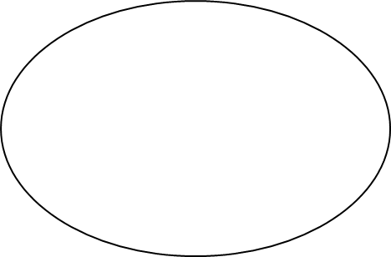
Numeracy and Maths at Oyne School
Aims: At Oyne School, we aim to foster a love of numeracy and maths and the belief that everyone can be successful mathematical thinkers, pattern spotters and problem solvers! We aim to provide opportunities for learning based on problem solving, reasoning and fluency that promote deep engagement and build our young people’s comprehension of numeracy and maths across the curriculum. | DYW: Skills for Life, Learning and Work Collaboration Communication Problem Solving Creativity Self-Management Resilience
Quality Teaching and Professional Learning All pupils should receive high-quality teaching from teachers who are committed to their own professional learning. Our Staff: Are commitment to the improvement of teaching and learning through building on strengths and tackling key areas for improvement. Are informed by research and collaborative enquiry Are self-critical and reflect on their practice Engage in relevant CPD opportunities Promote Growth Mindset Demonstrate enthusiasm | Growth Mindset in Numeracy and Mathematics
Key Features of a Lesson Whole class starter activity - consolidates learning/addresses misconceptions - increases fluency Whole class Anchor Task/Problem - assesses previous learning - provides opportunity for discussion and reasoning - Learning Intentions and Success Criteria agreed Guided Practise/Teacher input - different resources and strategies encouraged Independent Practise - differentiated as appropriate Plenary - Focussed on discussion of strategies and learning - related to Learning Intention and Success Criteria | The Oyne School CPA Approach
Variety of reporting methods used to highlight progress/next steps
Learners are at the heart of all we do
Everyone can learn and achieve in maths
Mistakes are valuable
Questions and discussions are important
Maths is about creativity, communication and making connections
Depth is more important that speed
Thinking should be made visible – jottings/whiteboards encouraged
Play based and engaging
Feedback is linked to SC and next steps identified
Plan learning, teaching and assessment to meet learners needs
“To face the
challenges of the 21st Century, each young person needs to have confidence using mathematical skills, and Scotland needs both specialist mathematicians and a highly numerate population.”
BTC1
Progression Frameworks and Benchmarks used to evaluate progress
Learning Intentions reflect the standards, SC are clear and relevant
Research suggests that there are three steps necessary for pupils to develop understanding of a concept: Concrete – Pictorial- Abstract
Key elements of this approach:
Concrete
Bar Model
Numberline
Pictures and stories
The Expanded Method
Formal Method
Wide range of evidence is gathered and informs planning and assessment
There is a balance between ongoing and periodic assessment which informs planning
Focus on CPA , play based approaches and outdoor learning experiences
Collaborative | Problem solving, reasoning, fluency | Innovative teaching based on research | High quality feedback
Key Resources Wide range of solid resources including Tens Frames, Place Value Discs, Base Ten etc Leckie and Leckie Primary Maths for Scotland Big Maths Beat That, Timetable Rockstars, Sumdog, Prodigy White Rose Maths/Nrich/Power of 2 (support) | Partnership Working and Pupil Voice We strive to ensure that all stakeholders are involved in planning how and what we learn and we regularly share our learning. We do this through: Consultation using HGIOS and ‘wee’ HGIOS - Reporting through SeeSaw Learning Circles - Family Learning events Quality Improvement Pupils (QIPs) - Seeking views and opinions | Planning and Assessment We ensure appropriate pace, challenge and understanding of ‘on-track’ learning using the following documents: Northern Alliance MNU Progression Framework Glasgow Counts materials

