Slide 1
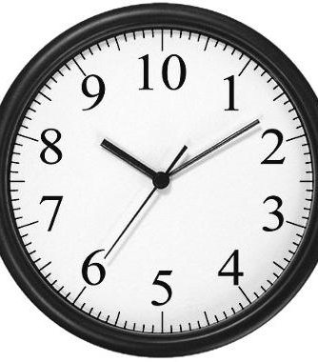
Time
On Monday’s and Tuesday’s we will be moving on to learn about Time.
This Photo by Unknown Author is licensed under CC BY-SA

Slide 2
Facts!
60 seconds in 1 minute
60 minutes in 1 hour
24 hours in 1 day
365 days in 1 year (366 in one leap year)
10 years in a Decade
100 years in a Century
1000 years in a Millennium

Slide 3
How many days in each month?

Slide 4
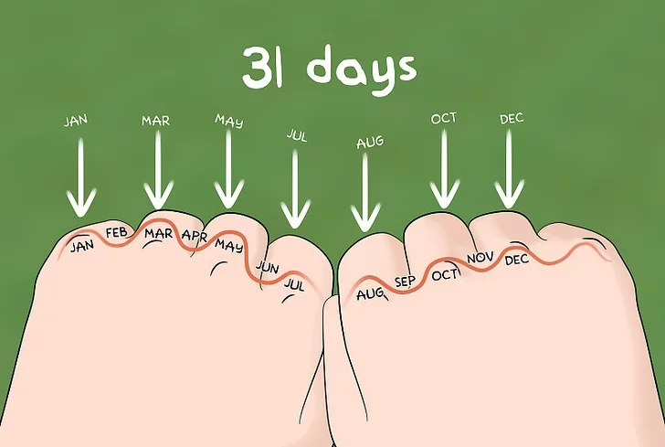
You can use your knuckles to help remember the number of days in each month…

Slide 5
What is your time story?
Write your time story in your Maths jotter. You could refer to minutes, hours, days, weeks, months, years, decades, century’s and/or millenniums.
My story is… I was born in 1987. I have been alive for 32 full years. Today marks me being alive for 1680 weeks which is also 11760 days!! I have lived in 5 decades, two centuries and in two millenniums. I have been alive in 9 leap years.

Slide 6
Education City
I have set you a task on Education City to help you with your prior learning in time and to challenge your thinking with new learning. On Monday’s and Tuesday’s we will be learning about time for the next couple of weeks.
I have set the task to start today (Tues 24th) and to finish on Friday (27th).
Good luck!

